Slide 1
Chapter 16 Introduction of 3D Stereo Vision
(Theme 4)
Prof. Lin ZHANG
School of Computer Science and Technology
Tongji University

Slide 2
Problem definition of 3D stereo vision
3D stereo vision is an important branch of computer vision technology. This technology involves analyzing images or video sequences to achieve perception and understanding of the three-dimensional world
Depending on the specific application, 3D stereo vision technology generally addresses the following three types of problems:
Depth Estimation: Inferring the distance from each pixel in an image to the camera, i.e., depth information, to achieve a stereoscopic perception of the scene
3D Reconstruction: Recovering the 3D structure of objects from 2D images or videos, including their shape, size, and position
Motion Estimation: Analyzing the motion information of objects in a sequence of images, including their speed, direction, and acceleration

Slide 3
Problem definition of 3D stereo vision
For a 3D stereo vision system, the typical input and output data types are described as follows:
Input: Usually a set of 2D images or video sequences, which may also include intrinsic and extrinsic camera parameters
Output: Includes 3D point clouds, 3D models, depth maps, motion trajectories, and other information used to describe the 3D structure and motion of a scene

Slide 4
Problem definition of 3D stereo vision
When building a 3D stereo vision system, the following types of sensors are commonly used:
Cameras: Used to capture 2D images or video sequences, serving as the primary input source for 3D stereo vision technology
Depth sensors: Such as structured light sensors and time-of-flight sensors, used to obtain the distance information from each point in the scene to the sensor
Inertial Measurement Units (IMUs): Used to measure the acceleration and angular velocity of objects, assisting in motion estimation
LiDAR: Uses laser beams to measure the time of flight and obtain the 3D position information of objects in the scene, commonly used for 3D reconstruction in outdoor environments
Camera arrays: Composed of multiple cameras, used to capture multi-view image information for more accurate 3D reconstruction and stereo matching

Slide 5
Problem definition of 3D stereo vision
Today, 3D stereo vision technology is widely applied in many fields, including but not limited to the following:
Industrial manufacturing: Through 3D reconstruction and inspection techniques, it is possible to detect the 3D shape and surface defects of products, improving product quality and production efficiency
Medical imaging: In medical imaging, the technology is used for the reconstruction, analysis, and diagnosis of medical images
Virtual reality: By tracking and reconstructing the user's viewpoint and movements, it enables free movement and interaction within the virtual environment
Autonomous driving: By performing 3D reconstruction and recognition of the vehicle's surroundings, it enables autonomous navigation and obstacle avoidance
Robotic vision: By reconstructing the environment and recognizing targets, it helps robots better understand and respond to complex environments

Slide 6
Contents of this theme
Among the many 3D stereo vision techniques, binocular stereo vision is the most fundamental and important; We will detail the construction of binocular vision systems in Chapter 17
Neural Radiance Fields (NeRF)-based 3D reconstruction technology uses neural networks to simulate radiance fields for 3D scene reconstruction and understanding. It involves two key steps: radiance field modeling and scene rendering. We will introduce NeRF-based scene rendering techniques in Chapter 18

Slide 7
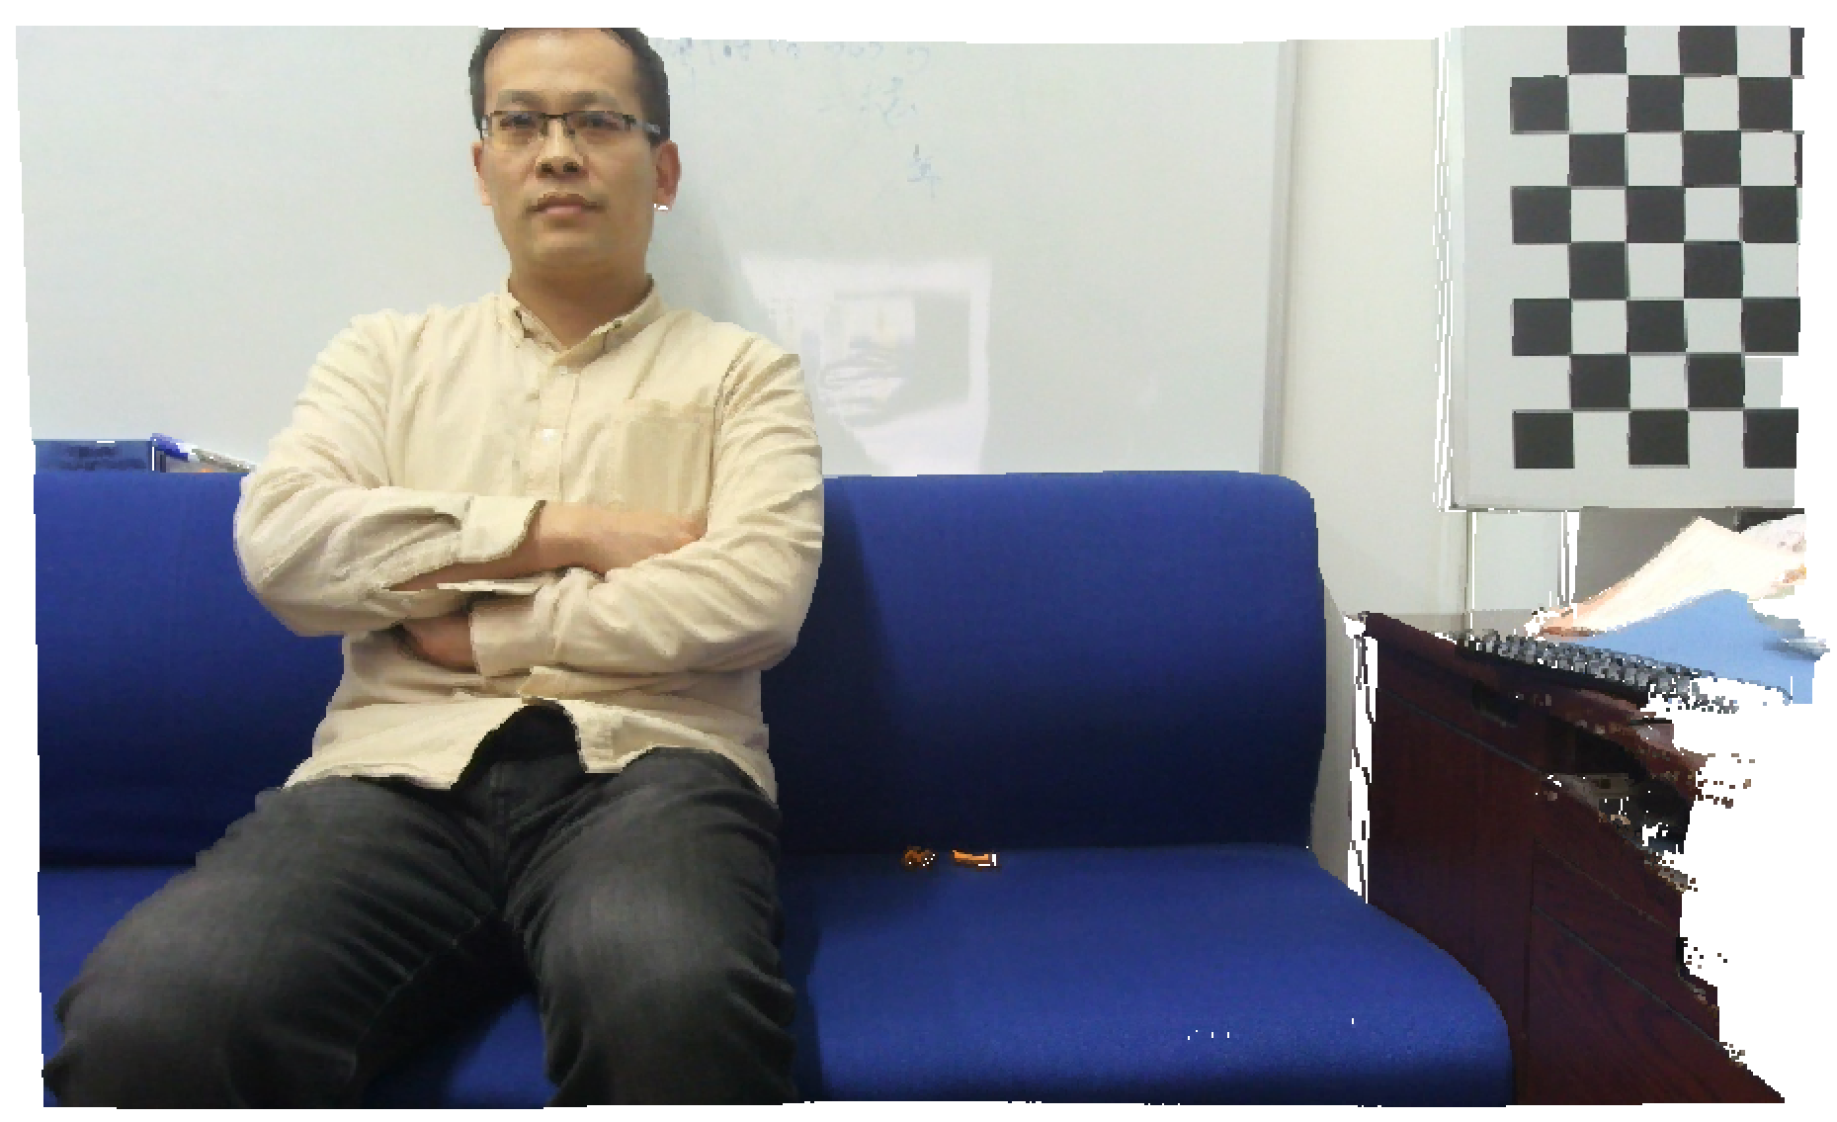
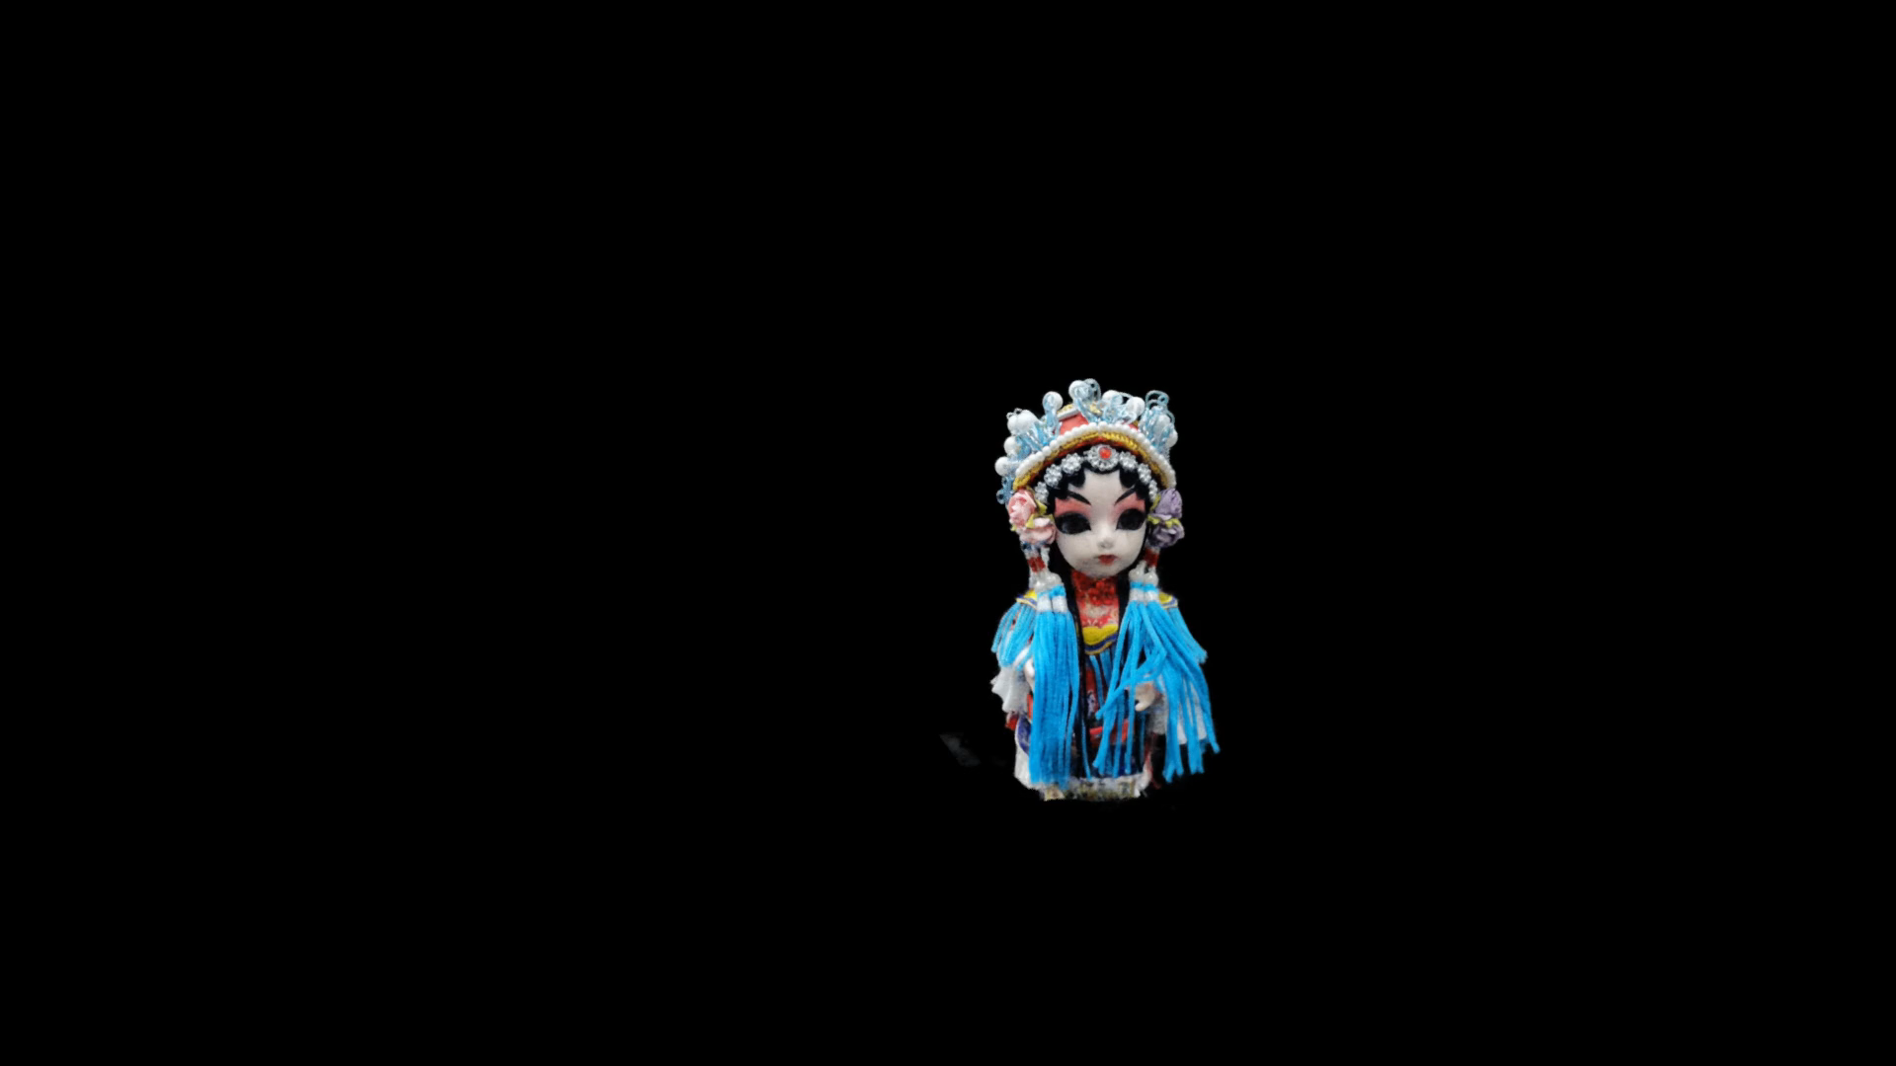
Contents of this theme
2.5D reconstruction using the binocular technique
Neural field rendering result using Instant-NGP

Slide 8
Contents of this theme
应用
三维物体重建
自动驾驶中的目标测距
产品逆向工程
AR/VR
场馆虚拟漫游
机器人导航避障
技术
双目立体视觉系统构建
基于神经辐射场的三维场景渲染
双目外参标定
双目校正
块匹配
神经辐射场的学习
算法
加权最小二乘滤波
三角化测距
神经渲染
体渲染
数学
罗德里格斯公式
旋转的轴角表达
非线性最小二乘问题
对极几何
射影几何
高斯牛顿法
L-M法
本质矩阵与基础矩阵

Slide 9


